Slide 1
Unified Process

Slide 2
What is the Unified Process
A popular iterative modern process model (framework) derived from the work on the UML and associated process.
The leading object-oriented methodology for the development of large-scale software
Maps out when and how to use the various UML techniques

Slide 3
The Most Important UP Idea: Iterative Development
The UP promotes several best practices, but one stands above the others: iterative development.
In this approach, development is organized into a series of short, fixed-length (for example, four week) mini-projects called iterations.
The outcome of each is a tested, integrated, and executable system.
Each iteration includes its own requirements analysis, design, implementation, and testing activities.

Slide 4
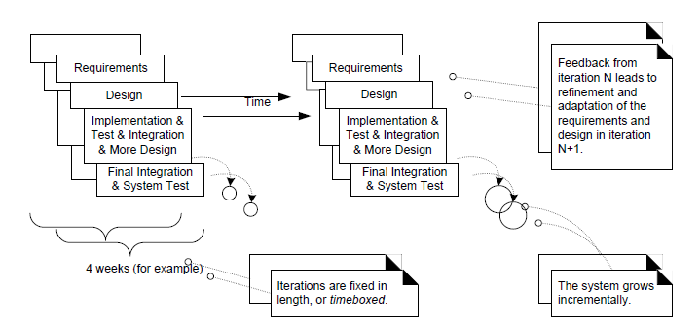
Iterative and incremental development
The system grows incrementally over time, iteration by iteration, and thus this approach is also known as iterative and incremental development.

Slide 5
Iteration result..
The result of each iteration is an executable but incomplete system.
The output of an iteration is not an experimental or throw-away prototype, and iterative development is not prototyping. Rather, the output is a production-grade subset of the final system.

Slide 6
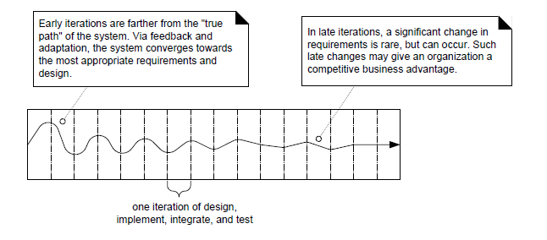
Iterative feedback and adaptation leads towards the desired system.

Slide 7
Benefits of Iterative Development
It includes:
early rather than late mitigation of high risks (technical, requirements, objectives, usability, and so forth)
early visible progress
early feedback, user engagement, and adaptation, leading to a refined system that more closely meets the real needs of the stakeholders
managed complexity; the team is not overwhelmed by "analysis paralysis" or very long and complex steps
the learning within an iteration can be methodically used to improve the development process itself, iteration by iteration

Slide 8
Iteration Length
The UP (and experienced iterative developers) recommends an iteration length between two and six weeks.
Much less than two weeks, and it is difficult to complete sufficient work to get meaningful throughput and feedback;
Much more than six or eight weeks, and the complexity becomes rather overwhelming, and feedback is delayed.
A very long iteration misses the point of iterative development.
Short is good.

Slide 9
Time-boxed
A key idea is that iterations are time boxed, or fixed in length.
For example, if the next iteration is chosen to be four weeks long, then the partial system should be integrated, tested, and stabilized by the scheduled date—date slippage is discouraged.
If it seems that it will be difficult to meet the deadline, the recommended response is to remove tasks or requirements from the iteration, and include them in a future iteration, rather than slip the completion date.

Slide 10
The UP Phases
A UP project organizes the work and iterations across four major phases:
1.Inception—By the end of this phase a business case should have been made; feasibility of the project assessed; and the scope of the design should be known.
2.Elaboration—takes us to a working specification of the system. By the end of this phase a basic architecture should have been produced; a plan of construction agreed; all significant risks identified; and those risks considered to be major should have been addressed.
3.Construction- By the end of this phase a working system should be available, sufficient for preliminary testing under realistic conditions.
4.Transition—produces beta-release system.During this phase the product is installed in the user’s environment and maintained.

Slide 11
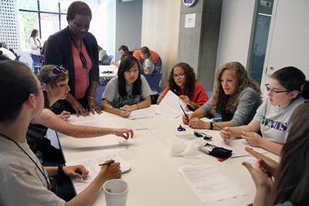
INCEPTION
Develop a good Idea into a vision of the end product.
Business case for the product is presented.
Establish Goals
Build Business case
Identify essential system requirements.
Initiate risk management(cost, time, political environment)

Slide 12
Elaboration
Here, architecture is expressed as a view of different models .
Develop architecture
Capture functional requirements as use cases.
Identify non-functional requirements.
Plan the construction.
Continue risk management.

Slide 13
Construction
Muscle built: Software added to the architecture.
Build the system
Maintain architecture integrity (Architecture is stable but might has minor changes).
Iterative , Incremental

Slide 14
Transition
Products move to beta release
trial
defects and deficiencies are reported.
Corrections and Improvements:
Final testing(system , acceptance, beta)
training customer personnel
Documentation, installation and consultation.
Perform postmortem review.

Slide 15
Imp point about phases.
This is not the old "waterfall" or sequential lifecycle of first defining all the requirements, and then doing all or most of the design.
Inception is not a requirements phase; rather, it is a kind of feasibility phase, where just enough investigation is done to support a decision to continue or stop.
Similarly, elaboration is not the requirements or design phase; rather, it is a phase where the core architecture is iteratively implemented, and high risk issues are mitigated.

Slide 16
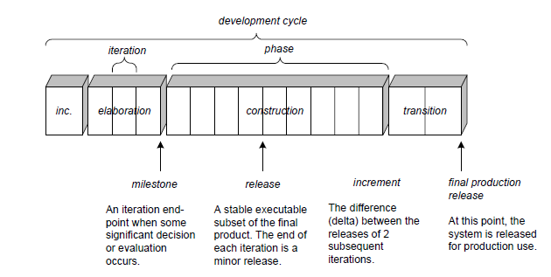
Schedule-oriented terms in the UP.

